Slide 1
Well-being for Travellers Supporting Communities to become Smokefree
Val Mills, Smoking Cessation Lead
Nicki Blyth, Deputy Team Lead
Bucks Smokefree Support Service

Slide 2
Introduction
Bucks smoking prevalence is 16%
Approx 62,358 adult smokers
Affluent rural population with pockets of deprivation
Estimated 1500 Gypsies and Travellers including 450 children resident in Buckinghamshire
Innovation project funding to increase access to our service for hard to reach ethnic minorities (£3000)

Slide 3
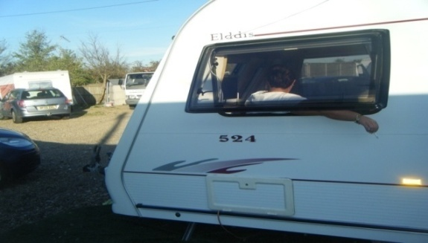
Background
High levels of poor health
Anecdotal evidence of high smoking prevalence
Less likely to access continuous health care
Anxiety about discrimination/prejudice = mistrust
Fear, fatalism and stoicism – especially males
High levels of illiteracy
Notes:
Suffer higher levels of poor health even than other communities of similar socio-economic status/marginalisation including tobacco-related illness
They die younger, suffer poorer mental health and more long-term illness. There is anecdotal evidence that smoking prevalence is high; alongside this chronic cough or bronchitis is 3 times more likely, diabetes is common, risk of premature death from cardiac disease in men is high as is self-reported anxiety and depression.
A number of permanent traveller sites in Bucks (mainly in the south of the county)

Slide 4
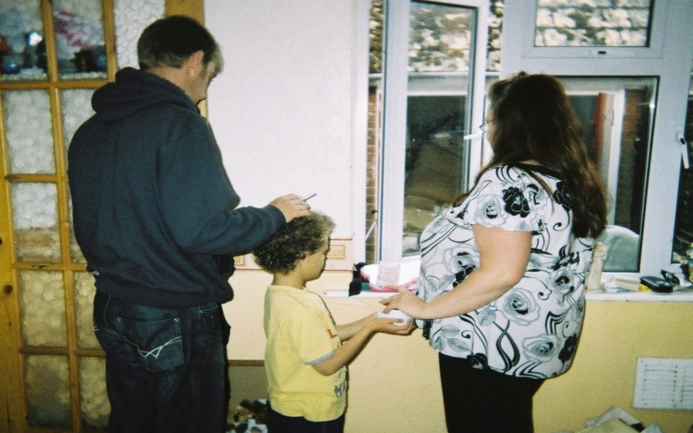
Aims
Raise awareness of health and social effects of smoking
Increase motivation to stop smoking
Raise awareness of Bucks Smokefree Support Service
Improve access to stop smoking support

Slide 5
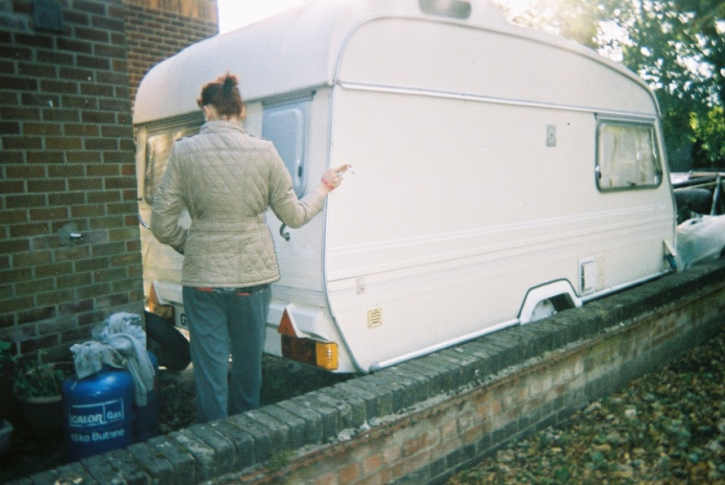
Objectives
Explore knowledge of smoking and health
Explore attitudes towards smoking
Train indigenous Smokefree Champions
Develop culturally relevant visual resources for use by Champions

Slide 6
Challenges
Distrust of authority
Disengagement with healthcare professionals
Hierarchy of authority within the community
Making contact
Low levels of literacy
They travel for long periods
Keeping in contact

Slide 7
Solutions
January 2011
Link with Health Advocate training “Wellbeing for Travellers”
NHS Buckinghamshire Public Health Dept
Bucks New University
One Voice for Travellers
May 2011
Drop-in interactive Information session
Wide range of visual aids
Informal conversation
Notes:
Building on/taking advantage of education and training already happening locally – addressing the issues around trust and linking quickly to interested and motivated individuals from the communities
One Voice – charity working across East Anglia & the Home Counties supporting families from the Gypsy & Traveller Community who have been affected directly or indirectly by violence – broader remit
One Voice = communication channel – promoted project to Traveller communities
Familiar surroundings (Bucks New Uni)
Backing of One Voice
Visual aids – understandable, encourage and enable dialogue
Building relationships

Slide 8
Working together
Involve the whole community -
Building on their experiences
Let them decide on how much or little involvement
Development of bespoke resources

Slide 9
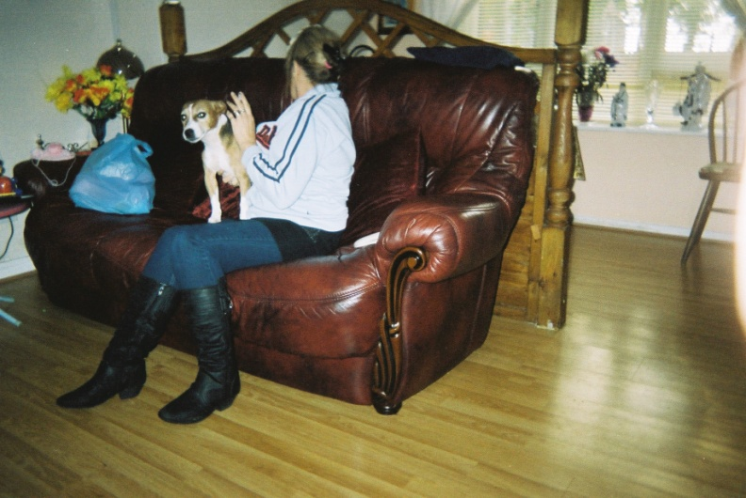
Action
May 2011
Brief Intervention training workshop
6 women Travellers
2 One Voice workers
Why do people smoke?
Effects of smoking
Benefits of stopping
Raising the issue
Motivation and behaviour change
Notes:
Two weeks after drop-in session
2 BSSS Advisers delivered training with support from PH and Uni staff
Interactive
Visual/3-D aids

Slide 10
Action
Autumn 2011 – Summer 2012
One Voice reported using the knowledge straight away
Development of portable resource pack
Photocards (photos from One Voice)
Visual aids
Basic CO monitor
DH and local leaflets
Shoulder bag
Notes:
Some of the photos were taken within the communities themselves – bearing in mind their hesitancy about being identified this was a huge bonus

Slide 12
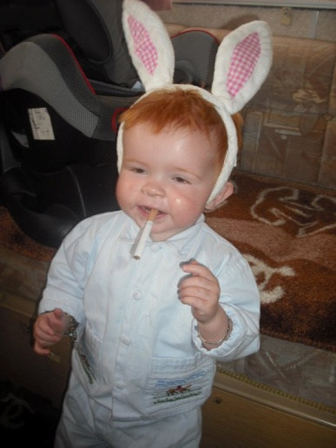
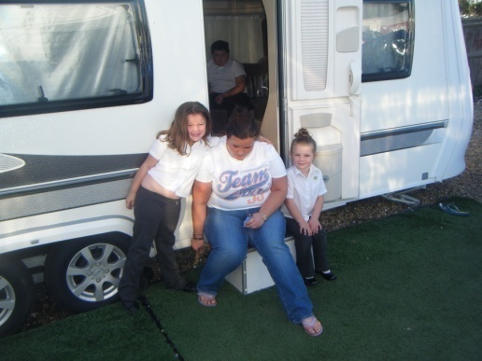
Results
Pack being used at least once a week
Young people
Women
Families
Groups and One to One
Health days/events
Community visits
Notes:
Three packs – Youth work, Community visiting and Health days/events
More in the summer – outside activities
Young people (youth leaders using the pack) – it’s not illegal so why the problem? Then show the poisons etc so even using with non-smokers in a preventative way. Generates lots of questions. Finding that quite common to start smoking at 25 due to pressure of life.
Women – challenge them that their children see them using cigarettes and Red Bull to get them through the day!
Families – challenging them to think about the qualities of their relationships where the children admit to hiding their smoking from parents
Who do they see as smokers and where do they smoke? – use photocards to challenge their view of smokers

Slide 13
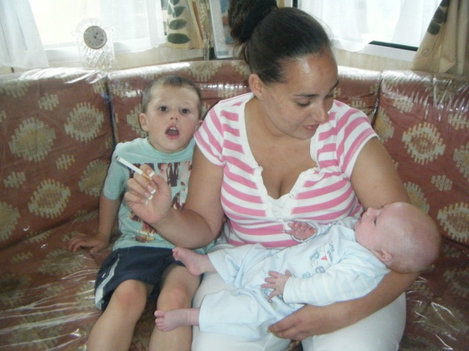
Results
Very positive feedback
Portable and compact
Generating questions (poisons)
Showing effects (CO monitor)
Challenge preconceptions (photocard)
7-8 people have stopped smoking
50% male
Unlikely to visit a clinic
Train own Practitioners?
Notes:
Flexible and easy to use in a wide range of situations
Sometimes using in a caravan – limited space!
Lots of visual stimulation
Photos directly link with their culture
There have been quits as a direct result of their work – have suggested training as Practitioners as it appears there may be reluctance to visit external clinics (One Voice do promote BSSS)
(Woman in picture is one who trained and also stopped smoking)

Slide 14
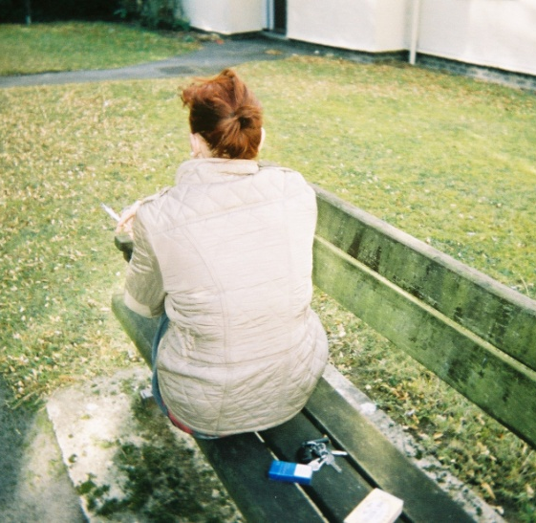
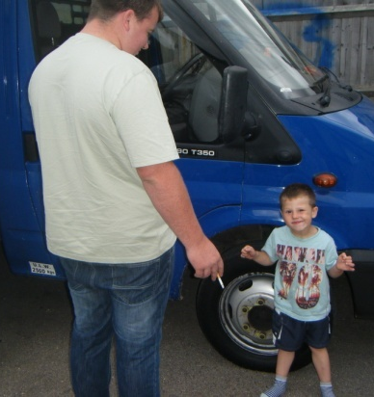
Key Principles and Values
Travellers smoke for the usual reasons
They have same smoking myths and beliefs
Issues around reaching the communities
Isolation
Anxiety about motivations of e.g. health professionals
Levels of illiteracy
Priorities
Notes:
Knowledge about smoking and reasons for smoking are no different (peer pressure, stress relief, weight control etc) – the issues are around reaching the communities as they tend to be isolated, partly through their anxiety about the other communities around them

Slide 15
Key Principles and Values
Building trust
Multi-agency working
Community Development
Allow time – travellers travel!
Notes:
Building trust is essential – providing photos taken within the communities is a sign that we achieved this!
Multi-agency - we benefited greatly from the ‘Wellbeing for Travellers’ programme that brought together health service, university and Traveller advocates (One Voice).
Community Development – a process that enables people to organise and work together to:
Identify their own needs and aspirations
Take action to exert influence on the decisions which affect their lives
Improve the quality of their own lives, the communities in which they live, and societies of which they are a part
Has taken time – working around their living pattern (periods of time when travelling!)

Slide 16
References
The Health Status of Gypsies and Travellers. Report to DH, Sheffield University, 2004; also published J Epidemiol Community Health, Van Cleemput, Parry et al, 2007
Inequalities experienced by Gypsy & Traveller Communities: A review. Equality & Human Rights Commission, March 2009

